Slide 1
Atomic Structure II
PC2232 Lecture 14
Angular Momentum, Spin & Periodic Table

Slide 2
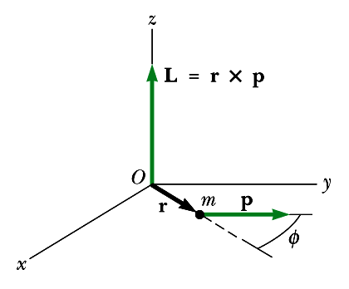
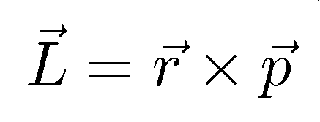

Angular Momentum
Angular momentum is a very important quantity in classical mechanics – plays a similar role in rotational motion as momentum plays in linear motion.
Total angular momentum is conserved when there is no external torque (moment of force) acting on it – similar to momentum being conserved if no external forces act on it.
Angular momentum L is defined by:
cross product
p
angular momentum
position vector
momentum

Slide 3

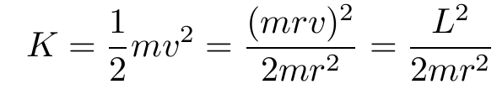
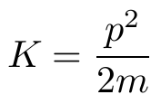
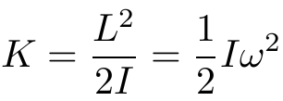



Some Rotational Quantities
For an object moving at constant speed v in a uniform circle around a point, the magnitude of the angular momentum L is simply
-e
m
Here, direction is “into the screen”.
F
Kinetic energy (in terms of the angular momentum)
+e
r
v
c.f.
Angular velocity:

Slide 4
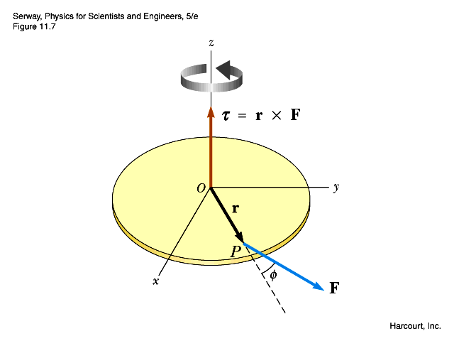

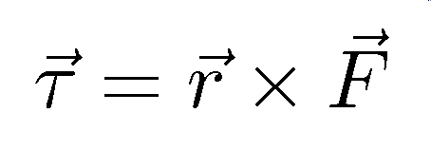
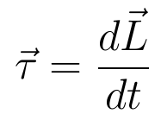
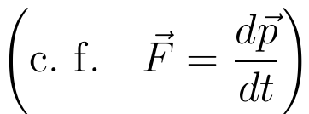
Torque & Angular Momentum
The quantity analogous to force in rotational motion is torque or moment of force. You have learnt earlier that moment τ = force × moment arm:
In vector form (3D):
An external torque causes a change in angular momentum of the system. It can be proved that:
d

Slide 5
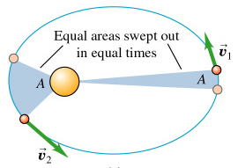
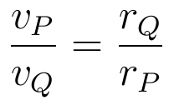

Examples of Angular Momentum
Planetary motion – Gravitational force also a central force ⇒ angular momentum is conserved because moment arm is always zero. Consider a more elliptical orbit, e.g., a comet.
Consider the point P nearest to the Sun, and Q furthest from the Sun. The position vector r is ⊥ to v, and by conservation of L:
P
Q
r_{P}
r_{Q}
The comet moves faster when it is closer to the Sun and slower when it is further away. It spends most of its time away from the Sun. In a similar manner:
An electron with a larger angular momentum has a larger probability to be found away from the nucleus!!
NASA

Slide 6
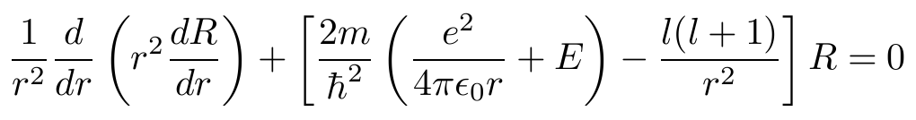
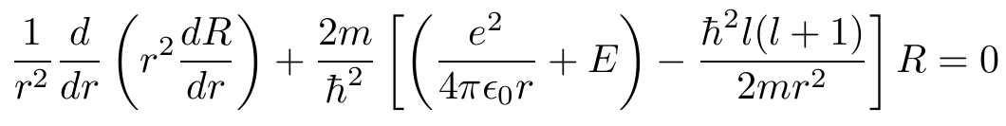
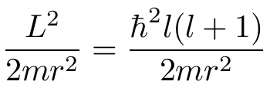


Angular Momentum in Hydrogen
We had earlier:
This is an energy term related the orbiting of the electrons about the nucleus. We can write:
So the electron can have only certain magnitudes of orbital angular momentum: !!
The angular momentum is quantized as in the Bohr model but with different values! The could also be more than one value for each n.

Slide 7
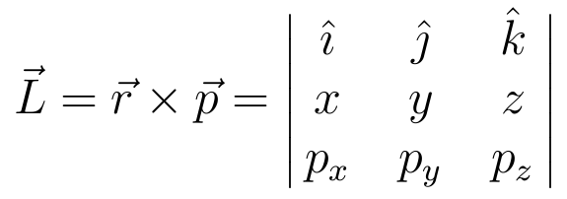

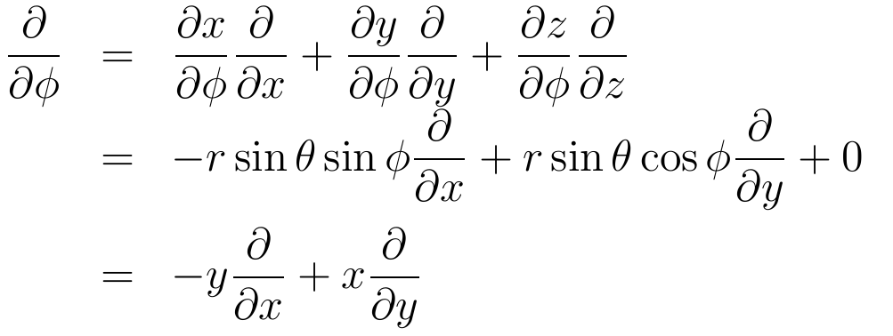
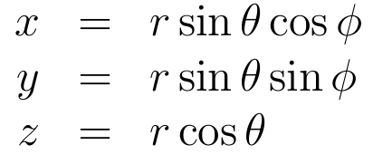
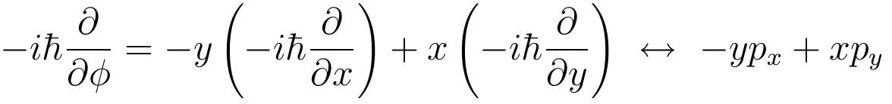
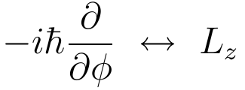
Meaning of m_{l} – some Mathematics
What does m_{l} represent?
In our definition of angular momentum:
Optional

Slide 8
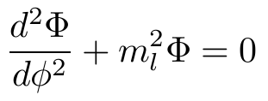

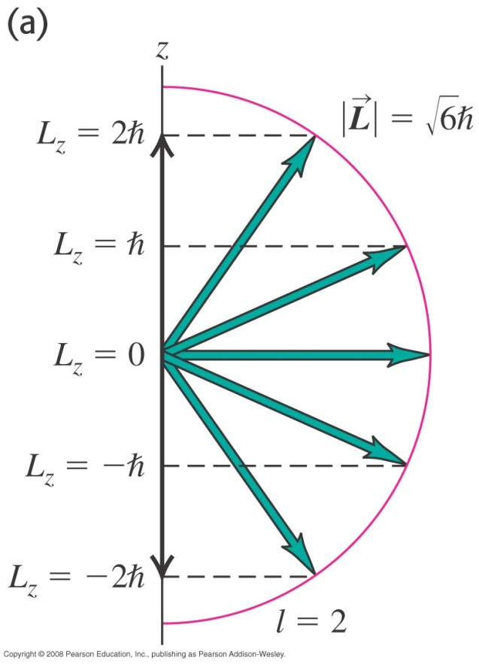


Orientation in space
We can interpret the quantum number m_{l}ħ as component of the angular momentum in the z-direction.
For every l, there are (2l + 1) possible values of m_{l}, or there can be (2l + 1) orientations of L.
For example for l = 2 (d-state)

Slide 9
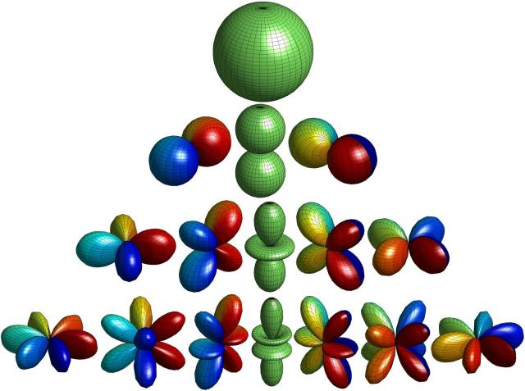
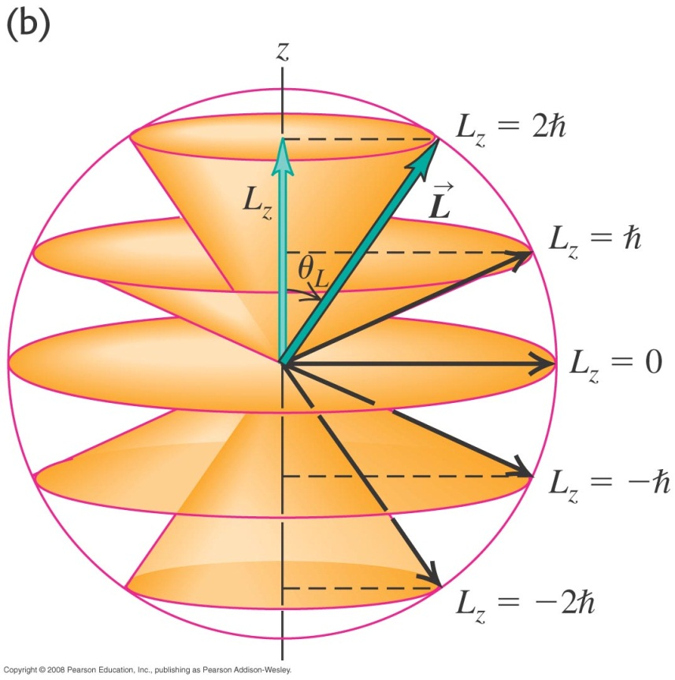
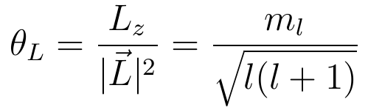
Orientation in space
Note that uncertainty principle also requires that if L_{z} = 2ħ, L cannot have the magnitude of 2ħ. Otherwise, L_{x} and L_{y} have both to be 0 and L would be known precisely (not possible in QM).
Thus we can visualize L as to be on cones that have “heights” of values m_{l}ħ = L_{z}.
The angle that L made with the z-axis is given by:

Slide 10
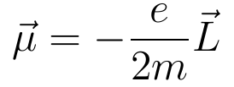

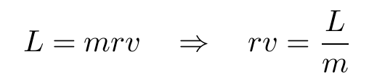

L and Magnetic Dipole Moment
An electron that has an angular momentum can be thought of as a current loop (viewed as a charge going around the nucleus) and has a magnetic field like that of a dipole moment μ.
From E&M, magnetic dipole moment is:
Definition of angular momentum:
-e
+e
m
r
v

Slide 11



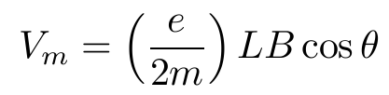

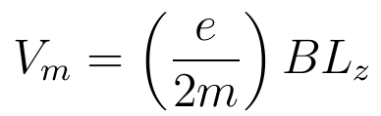
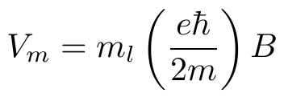

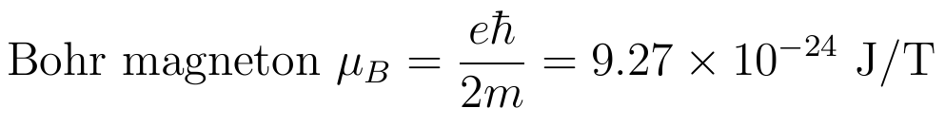
Atoms in Magnetic Field
When an atom is in a magnetic field of flux density B, the potential energy V_{m} due to interaction of μ with B gives:
Taking z to be the direction of magnetic field:
z

Slide 12
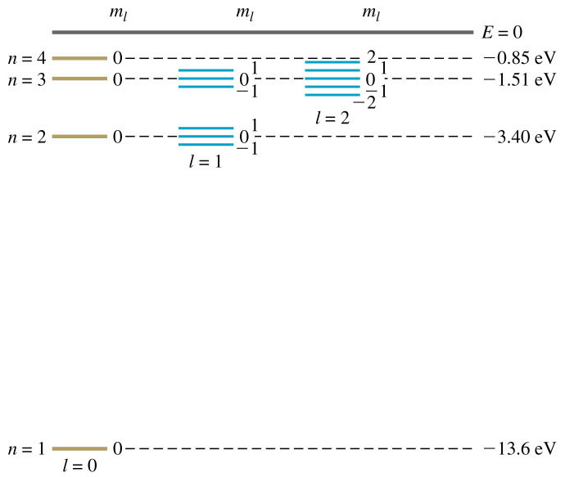
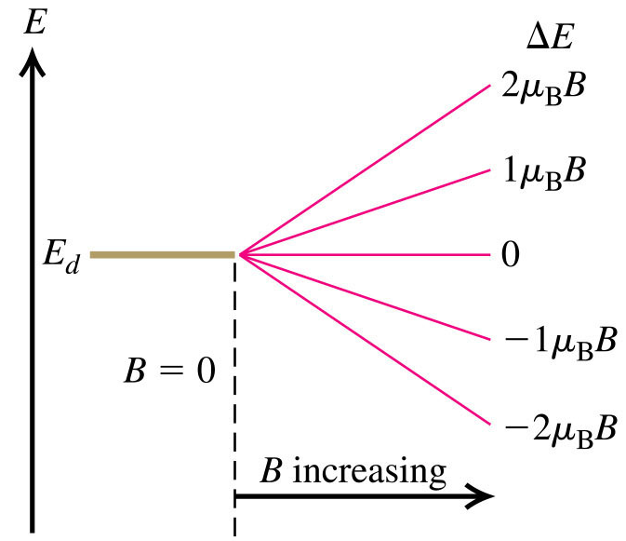
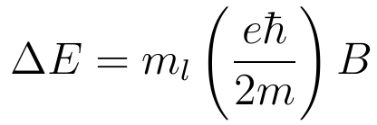
Splitting of Energy Level in B-field
Without magnetic field, different m_{l} states with the same n and l have the same energy. This degeneracy is removed in a magnetic field. They split into 2l + 1 distinct energy levels as seen below:
s-states
p-states
d-states

Slide 13
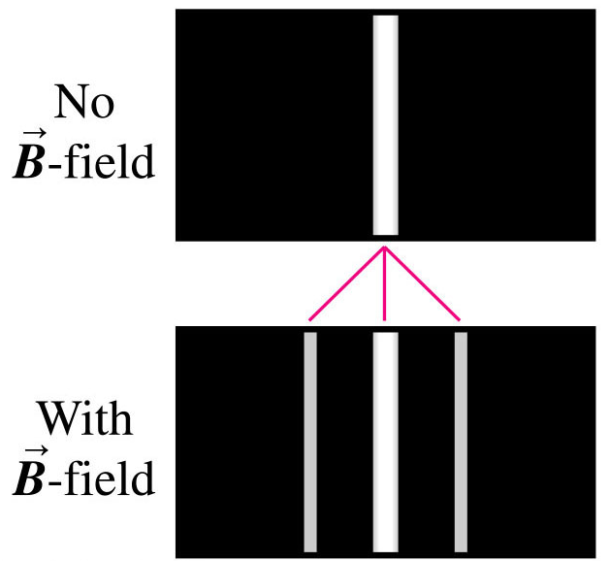
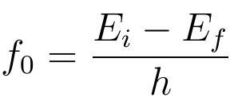
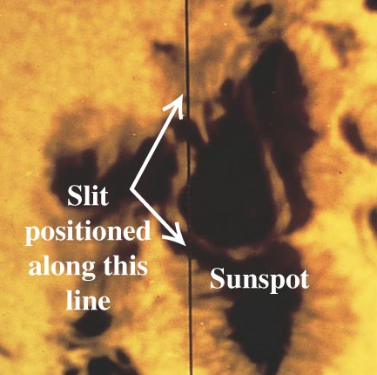
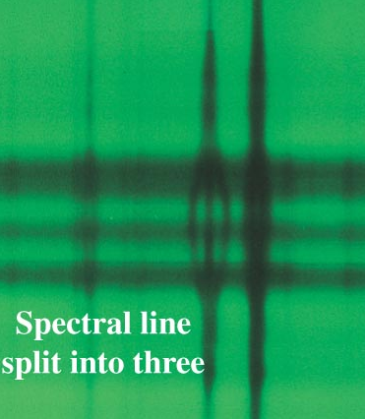
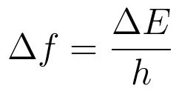
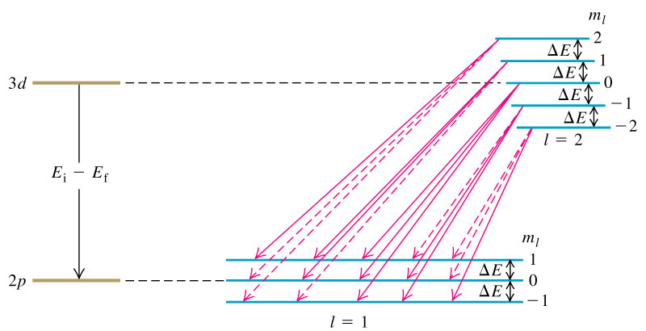
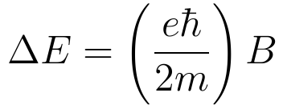


Normal Zeeman Effect
The splitting of energy levels resulted in three lines observed in many spectra. This was observed by Zeeman (1896) and also in sun spots.
The reason for only three lines are due to selection rules:

Slide 14
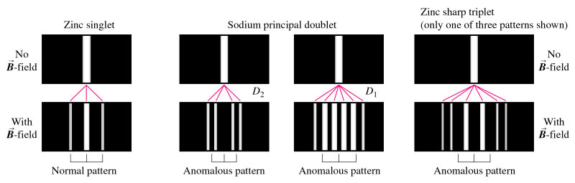
Anomalous Zeeman Effects
Not all splitting in the magnetic fields can be explained by earlier analysis!
Some spectra lines are multiplets (have a few closely spaced lines) even without a magnetic field. For example, the yellow line of sodium corresponding to 4p → 3s is a doublet (λ = 589.0, 589.6 nm).

Slide 15
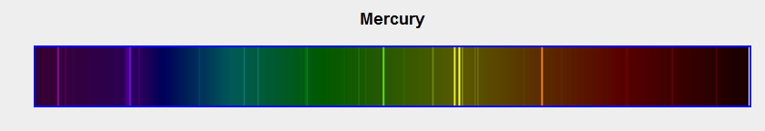
Mercury spectrum
An interesting observation.
Doublet: Lines that appear in pairs, having wavelengths which are very close to each other.
It was the challenge to explain these doublets that first gave rise to the idea of an electron spin with two possible orientations.

Slide 16
Electron Spin
In 1925, Sameul Goudsmidt and George Uhlenbeck, proposed that besides the orbital “motion”, the electrons may have an additional motion, similar to the spinning Earth going around the Sun. This will result in an additional spin angular momentum and magnetic moment.
This classical picture proves to be not accurate – e.g., resulting in motion of equatorial plane of electron higher than c.
Electron spin is an intrinsic property of the electrons. In fact all particles has an intrinsic character called spin, which may be zero, half-integer or integer.
While not attributed to the spinning of particles (and is better explained only in relativistic QM and Quantum Electrodynamics), the additional angular momentum due to spin explains most of the phenomena described earlier!

Slide 17
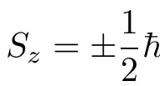
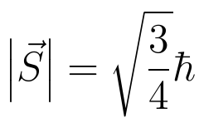
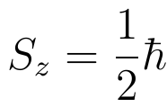
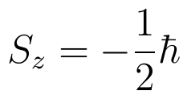
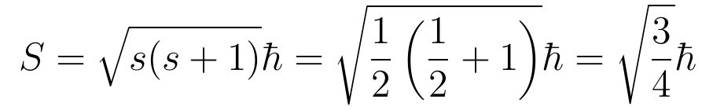
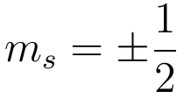

Spin Quantum Number
Like orbital angular momentum, the spin angular momentum (denoted by S) is also quantized. The only possible values of the z-component of S for an electron are found to be
z
The spin quantum number s for electron is therefore has only value of ½.
In a similar manner, the magnitude of spin angular momentum is:
To describe fully the state of electron in the hydrogen atom, we need another quantum number m_{s} which specified the spin orientation:
where

Slide 18
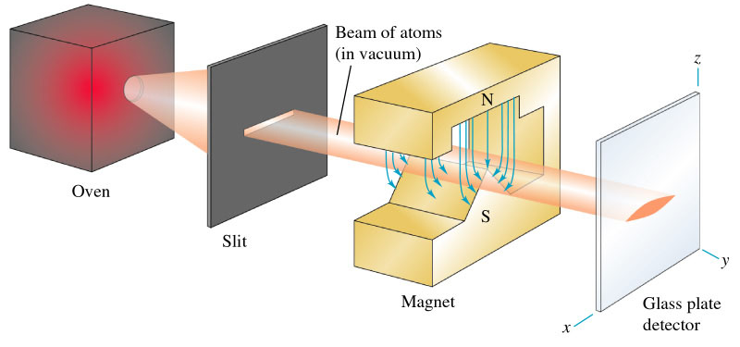

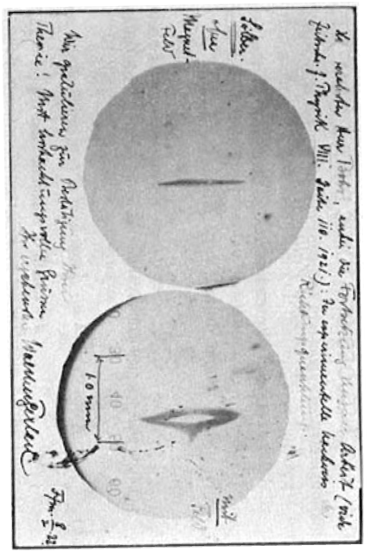
Pre-lecture: Stern-Gerlach Expt
??
w/o magnetic field
μ_{z}
S_{z}
S_{z}
with magnetic field
Spin up (m_{s} = ½)
Spin down (m_{s} = –½)
z
Splitting is due to the spin angular momentum of the electrons. Electron with spin up (m_{s} = ½) is pushed up by the inhomogenous field and vice versa for electron with spin down (m_{s} = –½). If S_{z} can take any value, the pattern will be wider and smeared out!

Slide 19

Spin Magnetic Moment
Similar to magnetic moment due to l, there is also a magnetic moment associated with s.
The spin magnetic moment is found experimentally to be
The numerical factor in the above equation – known as gyromagnetic ratio is about twice that of orbital angular momentum.
Its actual value has been calculated by Quantum Electrodynamics (QED) to about 15 significant figures which agrees to the recent measurements of 2.0023193043617 (15)! Probably the most precise measurement and theory of all sciences.

Slide 20





Quantum Numbers
We need four different quantum numbers to describe a state of hydrogen fully (n, l, m_{l} , m_{s}).
n is an integer 1, 2, 3, …
For each value of n there are n possible values of l
For each value of l, there are (2l + 1) possible values of m_{l}.
There are always only two value of m_{s}:
The number of states for each value of n is given by:

Slide 21


Fermions and Bosons
Another important aspect of spins is that it divides particles into two classes:
  Fermions – particles with odd number of half integer spins
  These include electrons, protons, neutrons, neutrino, omega Ω⁻. Obeys Fermi-Dirac Statistics. One consequence: no particles can occupy the same state (exclusion principle).
  Bosons – particles with 0 or integral spins
  These include photons, deuteron, α-particle, pions, gravitons, etc. They obeys Bose-Einstein statistics. Particles can be in the same state – at low enough temperatures, particles can all be in the lowest state – a condition known as Bose-Einstein Condensation.

Slide 22

Beyond Hydrogen
To solve exactly for any atoms other than hydrogen using the Schrodinger equation is extremely difficult (3 ordinates for each electron) – probably not even helium is solved exactly.
A very rough approximation is to ignore all interactions between electrons – each electron is under just under the influence of the nucleus which is a point charge of Ze – not a good approximation.
A better approximation is to treat the potential that the electrons see as the sum of that due to the nucleus of charge Ze and the averaged-out electron clouds due to the other electrons. This is called the central field approximation.
We can use again the single-electron wave functions but the potential U(r) is no longer purely Coulomb (not exactly ~ Ze/r).
We can still use the 4 quantum numbers we have derived for H:
l

Slide 23
Energy Levels for Other Atoms
In hydrogen atom, its energy is determined only by quantum number n (does not depend on l or m_{l}).
In other atoms, this degeneracy is partially removed. the energy is determined by both n and l.
This is because the probability densities of different l with same n are different at different r. The electrons with lower value of l has a higher overall probability to be nearer to the nucleus (due to the antinodes at low r – see R(r) graphs for same n, different l.).
This is consistent with angular momentum in classical mechanics – a particle of higher angular momentum are more likely to be found further away from the centre.
So, for electrons nearer to the nucleus, E is therefore higher because there is less screening of the nucleus by other electrons. They see a higher effective potential.
lower

Slide 24


Energy Levels for Other Atoms
E.g., in increasing energy order, for n = 3 the states are 3s, 3p and 3d. In fact the energy of 3d states is even higher than that of 4s states.
Sequence of quantum states (not to scale)
f
E
f
d
d
p
s
p
d
s
p
s
p
s
s
n = 1
2
3
4
5

Slide 25

Pauli Exclusion Principle
Fermions obey the Pauli exclusion principle – No two electrons can occupy the same quantum mechanical state – or in other words – no two electrons in an atom can have the same values of all four quantum numbers.

Slide 26

The Periodic Table
We can use the Pauli Exclusion Principle to obtain the ground state of atoms by progressively filling each of the lower energy states starting with 1s, 2s, 2p, 3s, 3p, 4s, 3d, ... . The number of electrons that can go into each shell (or subshells for each l) was determined earlier. The pattern of filling the shells provides an explanation for the periodic table proposed by Mendeleev in 1869.

Slide 27
The Periodic Table

Slide 28

Periodic Table
1s
1s
2s
2p
3s
3p
4s
3d
4p
5s
4d
5p
6s
5d
6p
7s
4f
5d
5f

Slide 29



Total Angular Momentum (optional)
Many of the closely spaced lines (e.g., doublet in sodium spectrum) are due to the spin-orbit coupling – scalar product of the angular momentum vectors L and S.
The orbital and spin angular momentum can combine in various ways. We defined the total angular momentum J as
The possible values of the magnitude J are given in terms of a quantum number j by:
When l = 1, j can be 3/2 or 1/2. These states are denoted by:
no of spin orientations
represents l = 1
value of j

